Slide 1

ECE 419/619 Electric Machines and Drives Induction Motor Drives
Scalar Control

Slide 2
Volts per Hertz Control (Chapter 14)
Also called
V by f or V/Hz
scalar control
Low cost / Low performance
Simple microprocessor implementation
Usually doesn’t involve a speed sensor (open loop)

Slide 3
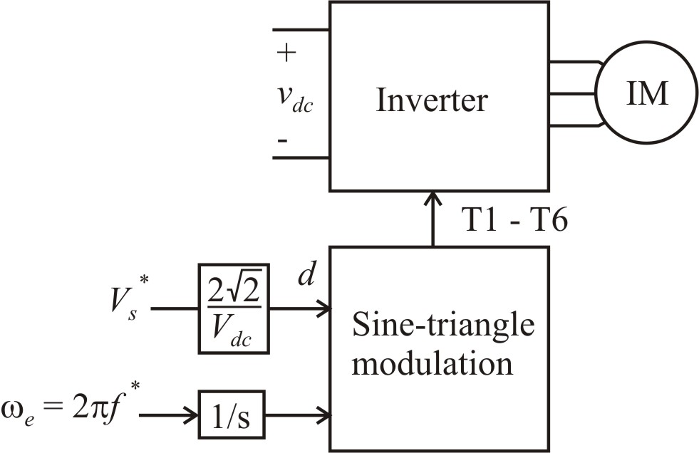
Speed Control Through Stator Frequency

Slide 4
Control of Voltage V_{s}*
keep constant
to avoid saturation
where ω_{b} is the base
(or rated) electrical frequency
and V_{b} is rated V_{s}
constant

Slide 5
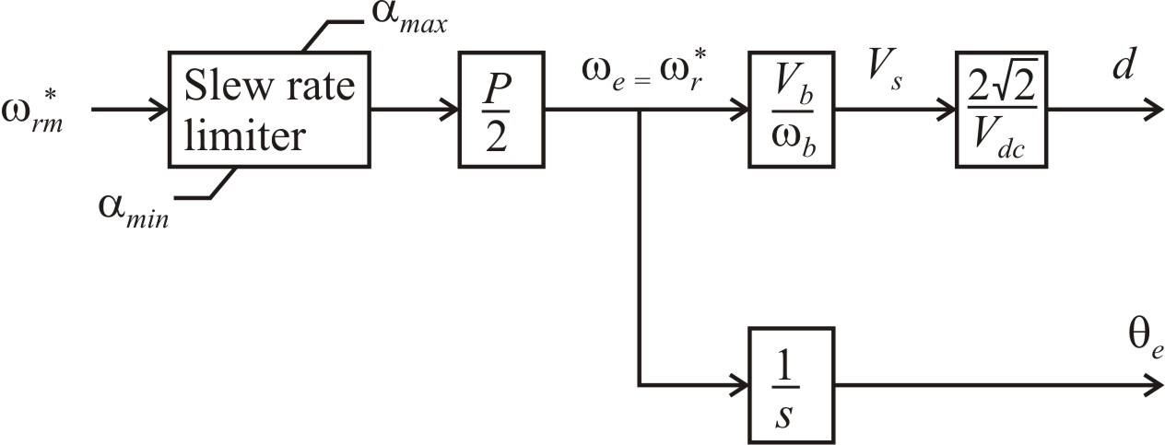
V/Hz Control

Slide 7
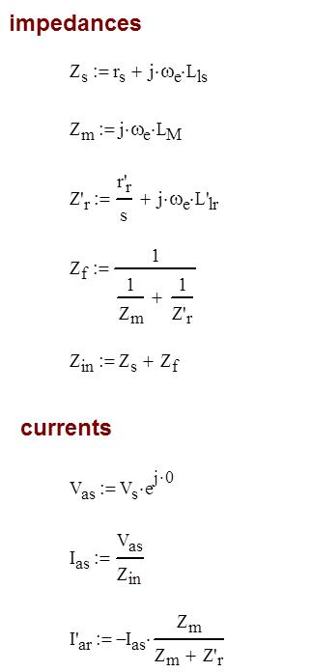

Slide 8
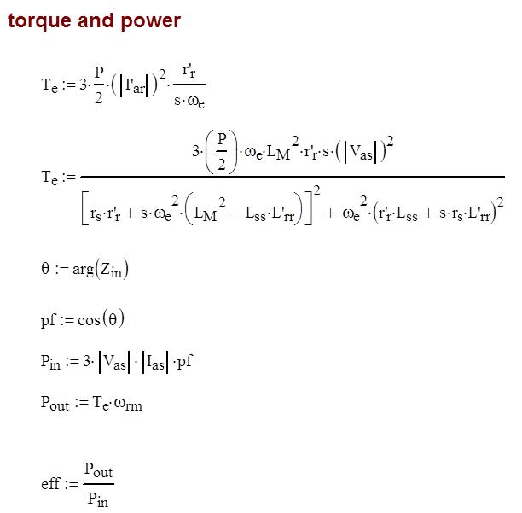

Slide 9
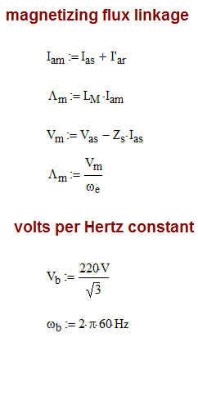

Slide 10
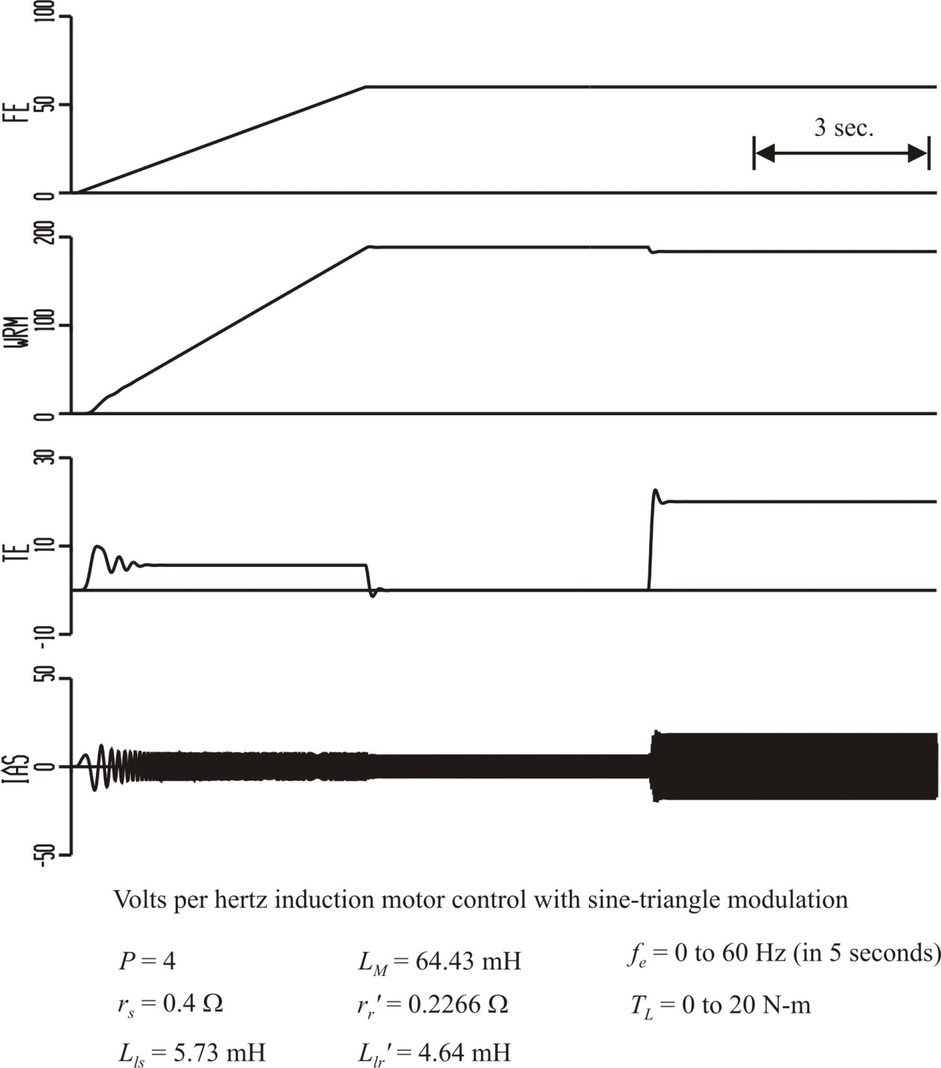

Slide 11
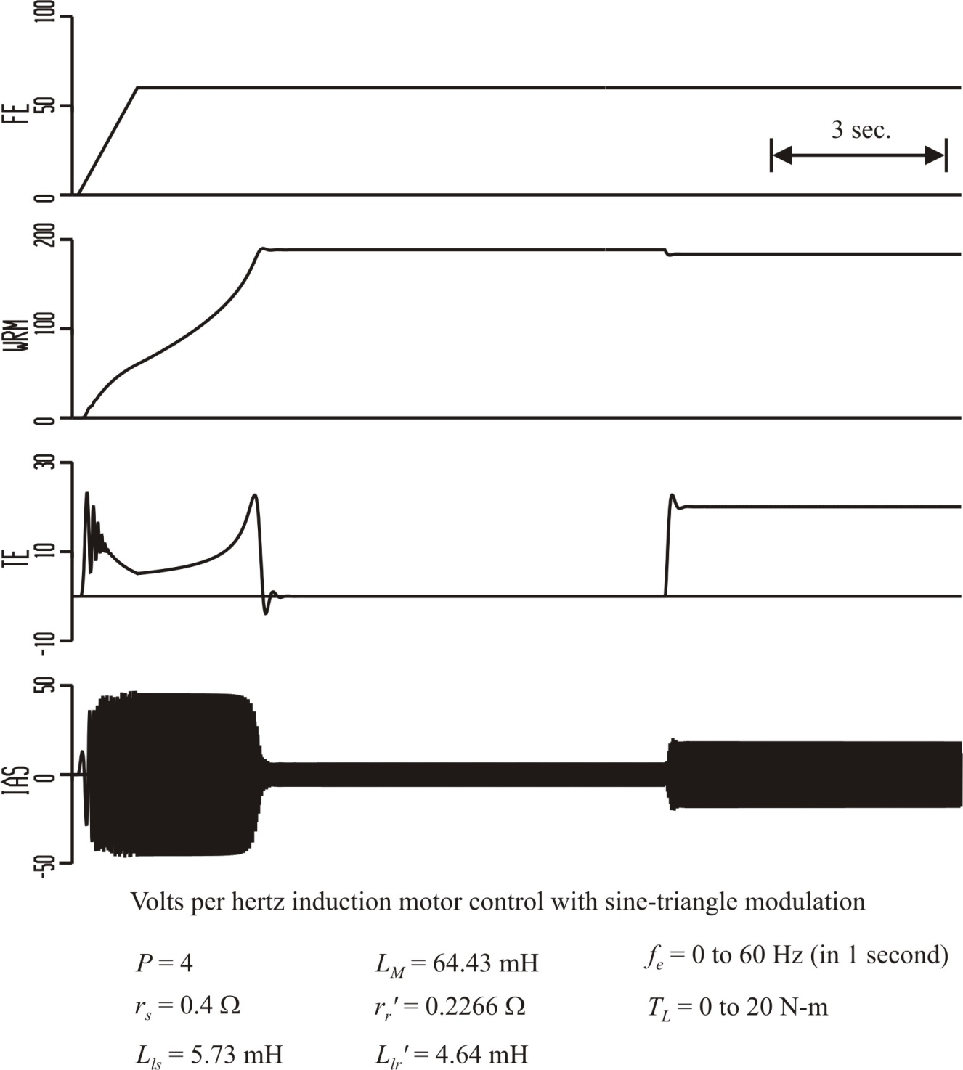

Slide 12
Drive Limits
frequency: from 0 to 160% of rated
voltage: from 0 to rated

Slide 13
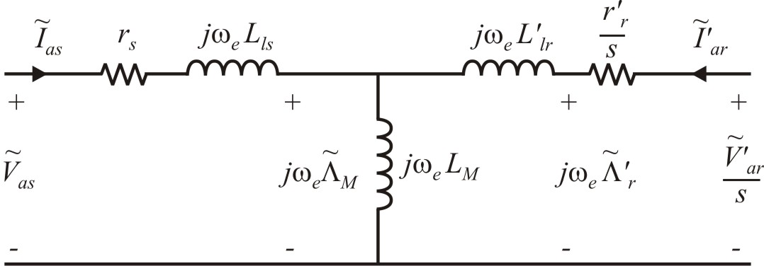
Low-Frequency Boost
~ ~
at low frequencies, r_{s} becomes significant, then V_{as} ≠ jω_{e}Λ_{M}
boost commanded
voltage at low
frequencies

Slide 14
Volts per Hertz Control for IM Drives
Straightforward, low-cost, low performance control typically without rotor speed measurement feedback
Commanded voltage is set proportional to commanded frequency in order to keep magnetizing flux at rated value; avoid saturation
Voltage is boosted at low frequencies to overcome stator resistance voltage drop

Slide 15
Maximum Efficiency Control
With current regulation: Chapter 14
With voltage-source modulation: B.T. Branecky and K.A. Corzine, "Power Factor Control for Increased Induction Motor Efficiency," Frontiers of Power Conference, pages VII-1 - VII-9, Stillwater OK, October 1998.

Slide 16
Efficiency From Steady-State Model

Slide 19
for maximum efficiency

Slide 20
Maximum Efficiency Control Example

Slide 21
Maximum Efficiency Control
Note: Power factor has an inverse relationship with voltage.
A closed-loop control can be set up based on power factor.

Slide 22
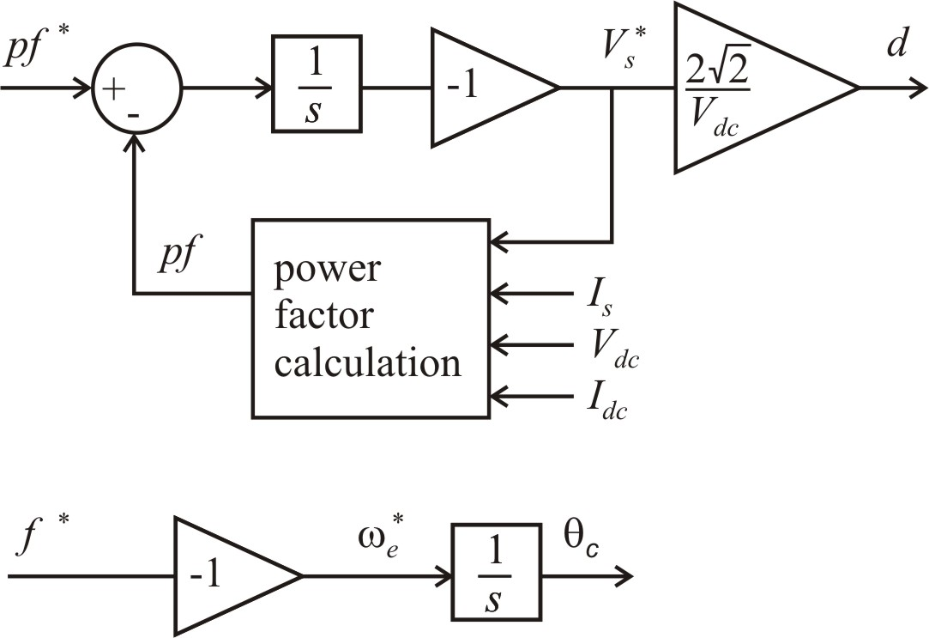
Control Diagram
Sensors
I_{s} - rms (not instantaneous)
V_{dc} - average (not instantaneous)
I_{dc} - average (not instantaneous)

Slide 23
Control Diagram
Commanded frequency
Power factor calculation
Commanded power factor

Slide 24
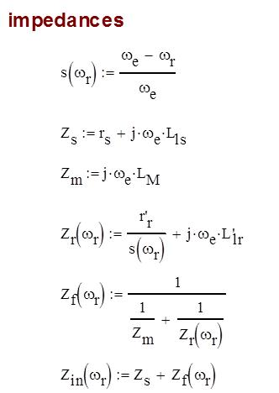

Slide 27
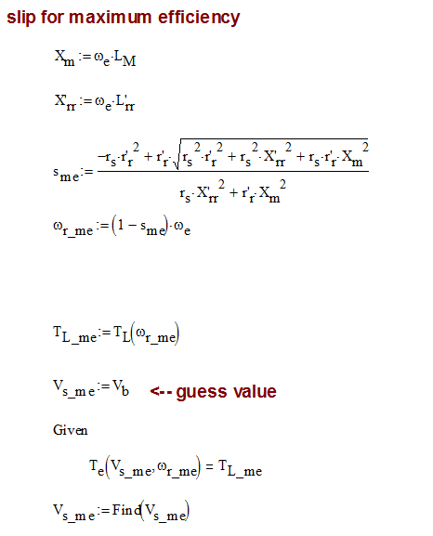

Slide 29
Maximum Efficiency Control for IM Drives
Type of IM control where the slip is set based on maximum efficiency
Chapter 14: Maximum efficiency control using current-regulated drive
Voltage-source drive can be used by regulating the power factor to its ideal value (based on slip for maximum efficiency)

